Slide 1
Core Java Project
ATM Interface
TASKEEN FATEMA
In The Guidance of POOJA MEHTA MA’AM

Slide 2
ATM Interface
View Balance
Withdraw Money
Deposit money
Transaction History
Exit

Slide 3
Introduction
In ATM(Automated Teller Machine) program, the user have to select the choice, given on screen.
The choices are view balance, withdraw money, deposit money, view transactions and exit.

Slide 4
To withdraw the money, we simply get the withdrawal amount from the user and remove that amount from the total balance and print the successful message.
To deposit the money, we simply get the deposit amount from the user, add it to the total balance and print the successful message.
To check balance, we simply print the total balance of the user.
To check the transaction we use map concept, and display the transaction.
We use the exit(0) method to exit from the current Transaction mode and return the user to the home page or initial screen.

Slide 5
Frontend : ---
Backend : java
Database : ---

Slide 6
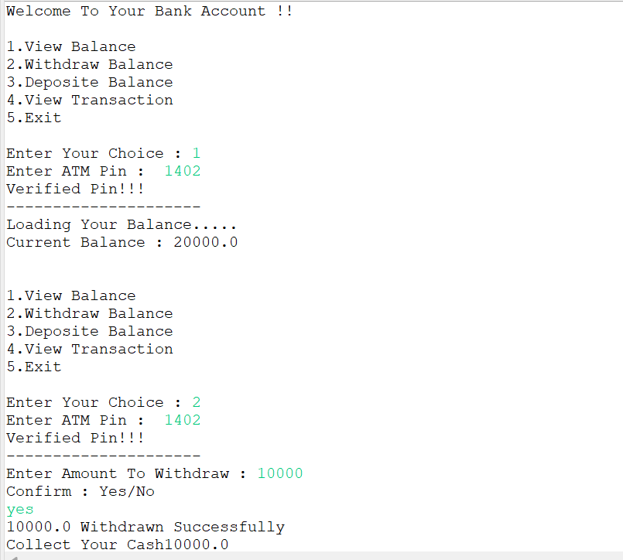
Program Output:

Slide 7
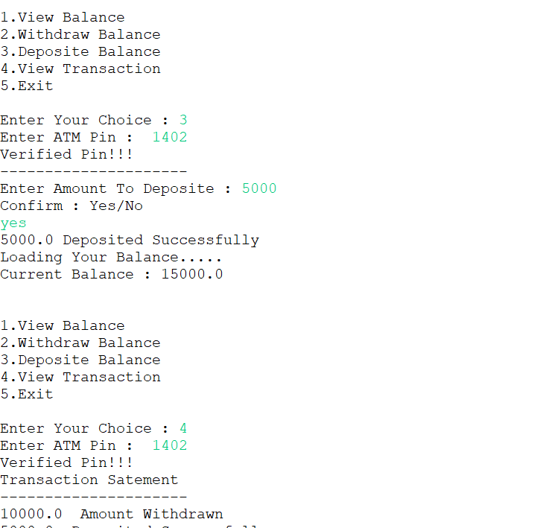

Slide 8
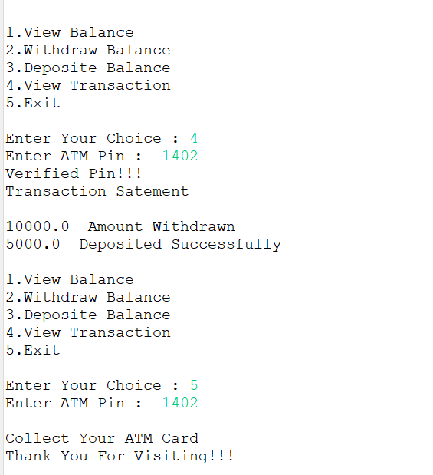

Slide 9
Thank You

